Slide 1

Software Engineering Project Review Report
Optimizing CVE Severity Prediction: A Hybrid TF-IDF and DistilBERT Approach with Attention-Based Deep Learning
Presented By:
Balavignesh – AV.EN.U4AIE22016
Devesh - AV.EN.U4AIE22027
Kabin Dev - AV.EN.U4AIE22015
Under the supervision of
Dr. Chandan Kumar
(Asst.Professor)
Department of Computer Science and Engineering
Amrita Vishwa Vidyapeetham, Amaravati Campus
Andhra Pradesh-522503

Slide 2
CONTENTS:
PROBLEM STATEMENT
INTRODUCTION
LITERATURE SURVEY
LITERATURE SURVEY OBSERVATION
MOTIVATION AND OBJECTIVE
WORKFLOW
RESULTS AND CONCLUSION

Slide 3
PROBLEM STATEMENT
Software vulnerabilities, like bugs or security flaws, can range from minor issues (e.g., a typo in code) to critical threats (e.g., a remote exploit that lets hackers take over a system). Each vulnerability comes with a description that explains what it does, but these descriptions are often long, messy, or full of details that don’t all matter equally. A regular model might get confused by all this noise and treat every part of the description the same, even though some parts—like “critical exploit”—are way more important than others, like “version number.” This can lead to wrong guesses about how serious a vulnerability is (e.g., calling a dangerous one “LOW” or a harmless one “CRITICAL”). The challenge is to build a system that can smartly focus on the most important clues in these descriptions to predict severity accurately.

Slide 4
INTRODUCTION:
Traditional classification methods rely on manual reviews or rule-based approaches, which are time-consuming and prone to errors.
Machine Learning (ML) and Natural Language Processing (NLP) techniques improve automation and accuracy in classification.
Hybrid models combining TF-IDF, BERT embeddings, and LightGBM can enhance classification performance.
Challenges:
Lack of Real-Time Classification: Most existing methods do not provide immediate insights.
Limited Multi-Model Approaches: Existing solutions do not effectively integrate NLP and ML.
Misclassification Risks: Rule-based methods often lead to incorrect severity assignments.
Scalability Issues: Traditional techniques struggle to handle large vulnerability datasets efficiently.

Slide 5
Real-Time Assistance: Implementing a classification model that provides immediate predictions for vulnerability severity, enabling faster threat mitigation.
Multi-Model Integration: Combining TF-IDF, BERT embeddings, and LightGBM to improve classification accuracy across different types of security vulnerabilities.
Advanced Techniques: Utilizing NLP and machine learning to enhance vulnerability classification beyond traditional rule-based methods.
Develop a hybrid model capable of accurately classifying vulnerabilities and providing risk assessments. (Goal)
Improve cybersecurity by automating and optimizing vulnerability classification, reducing manual effort and misclassification. (Motivation)
Create a scalable, lightweight, and effective classification system for large-scale vulnerability datasets.
Contribute to cybersecurity advancements by delivering a reliable, high-performance vulnerability classification system.

Slide 6
Literature survey:
Authors & Year | Title of the paper | Findings
Ehab Essa, Karima Omar, Ali Alqahtani (2022) | Fake News Detection Based on a Hybrid BERT and LightGBM Models | This paper proposes a hybrid fake news detection system that combines BERT-based embeddings with a LightGBM classifier, demonstrating improved accuracy over traditional methods.
Rushi Chavda, Darshan Makwana, Vraj Patel, Anupam Shukla (2023) | COVID-19 Self-Diagnosis Classification Using BERT and LightGBM Models | The study applied BERT embeddings with LightGBM for COVID-19 self-diagnosis classification. It demonstrated that hybrid models outperform standalone ML classifiers in text-based classification. This reinforces our use of hybrid approaches combining TF-IDF, BERT, and LightGBM for vulnerability severity prediction.
Patrick Kwaku Kudjo, Jinfu Chen, Solomon Mensah (2020) | The Effect of Bellwether Analysis on Software Vulnerability Severity Prediction Models | This study uses a Bellwether-based approach to enhance vulnerability severity prediction, improving F-measure (14.3%–87.8%) across four machine learning models.

Slide 7
Authors | Technique | Focus Area
Ruchika Malhotra, Vidushi (2025) | Improving Software Vulnerability Severity Prediction Model Performance with HDLN & FWFS | This study uses HDLN (CNN + Bi-LSTM) and FWFS (Information Gain + Grey Wolf Optimization), achieving AUC 0.88 and 0.86 for vulnerability severity prediction.
Ruchika Malhotra, Vidushi (2025) | Hybrid Feature Selection Module for Improving Performance of Software Vulnerability Severity Prediction Models on Textual Datasets | This study introduces P-GWO and MS-G2WO, achieving AUC 0.804 and 0.77, demonstrating improved vulnerability prediction using hybrid metaheuristic approaches.

Slide 8
Key Observations from the Literature Survey:
Automated tools are increasingly integrated into security workflows, but real-time classification support is still evolving.
Machine Learning (ML) and Deep Learning (DL) significantly improve vulnerability classification, surpassing traditional rule-based methods.
Existing tools primarily focus on specific patterns or code smells, with broader classification metrics often overlooked.
Many classification models are designed for single languages, lacking adaptability across multi-language security datasets.
Real-time classification solutions are emerging, but they are not yet widely adopted in vulnerability assessment.
Hybrid approaches integrating ML, NLP, and Reinforcement Learning (RL) offer more dynamic classification strategies.

Slide 9
Motivation
Automating vulnerability classification is crucial for improving cybersecurity response times and reducing manual effort. Traditional approaches struggle with accuracy and adaptability, often relying on static rules.
By integrating NLP and machine learning, this project enhances classification precision using a hybrid model of TF-IDF, BERT, and LightGBM. This approach not only ensures real-time, context-aware predictions but also provides a scalable solution for effectively identifying and prioritizing security threats.

Slide 10
OBJECTIVE
The goal is to create a neural network model that predicts how severe a software vulnerability is, based on its description. We want the model to use an attention mechanism—like a spotlight—to figure out which descriptions are most important for making the right call. By turning up the volume on key details and turning down less useful the model should make sharper, more reliable predictions. Ultimately, we aim to improve accuracy and help security experts prioritize the vulnerabilities that really matter.

Slide 11
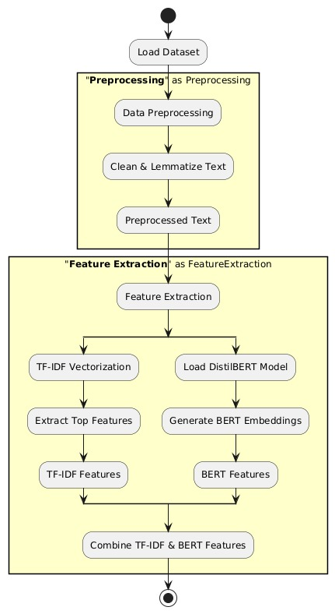
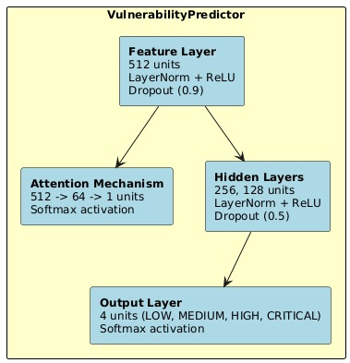
FLOWCHART:

Slide 12
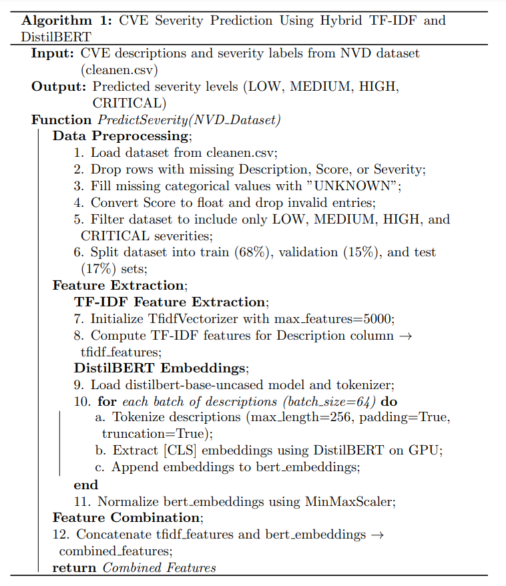
PSEUDOCODE:

Slide 13
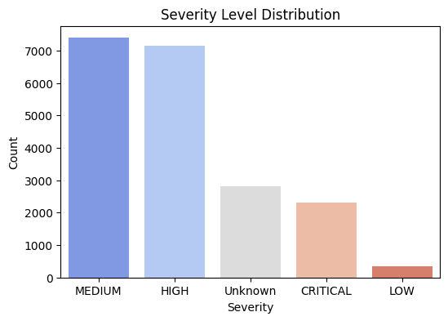
Dataset Processing (Combining Multiple JSON Files into a CSV File)
Preprocessing the Dataset
The following steps are performed to prepare the dataset:
Load all JSON files from the dataset folder.
Extract relevant fields:
CVE ID: Unique identifier for vulnerabilities.
Description: Text explaining the vulnerability.
CVSS Score: Numerical severity score (ranges from 0.0 to 10.0).
Severity Level: Categorical label (High, Medium, Low).
Merge all JSON files into a single CSV file for easy processing

Slide 14
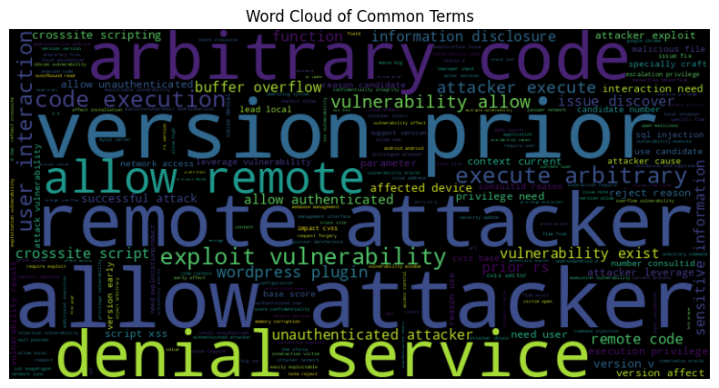
Data Cleaning and Preprocessing
Preprocessing Steps
Convert text to lowercase.
Remove special characters, numbers, and extra spaces.
Tokenize and lemmatize words using spaCy.
Remove stopwords to reduce noise in the data.
Example of Preprocessing
Before Cleaning: "Buffer Overflow leads to System Crash!"
After Cleaning: "buffer overflow lead system crash"
This cleaned text is now ready for feature extraction.

Slide 15
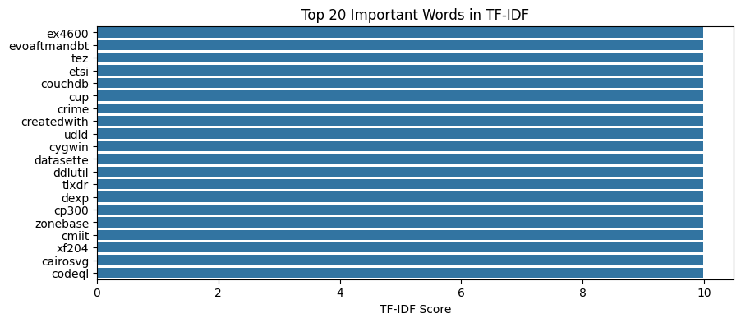
Feature Extraction
TF-IDF (Term Frequency-Inverse Document Frequency)
Converts text into a numerical vector based on word importance.
Captures how important each word is within the dataset.
Generates a 5,000-dimensional vector per vulnerability.
Spam Detection
Keyword Extraction
Text Summarization
Document Similarity & Search Engines
Feature Engineering for Machine Learning

Slide 16
Feature Extraction
BERT (Bidirectional Encoder Representations from Transformers)
Extracts deep contextual meaning from vulnerability descriptions.
Generates a 768-dimensional vector representing the semantic understanding of the text.
Feature Fusion (Combining TF-IDF and BERT)
The final feature vector is created by concatenating TF-IDF and BERT representations:
TF-IDF (5000 features) + BERT (768 features) → Final Vector (5768 features)
This ensures that both word importance and deep contextual meaning are captured.

Slide 17
Model Training using Attention Mechanism
Attention is a technique in neural networks that allows the model to focus on the most relevant parts of the input data when making predictions. Instead of treating all input features equally, it assigns weights to them based on their importance. This is inspired by how humans pay more attention to certain details (e.g., a critical keyword in a vulnerability description) while ignoring less relevant ones.
In our project, the input features come from a combination of TF-IDF and BERT embeddings derived from vulnerability descriptions. Some features might be more indicative of severity (e.g., terms like "remote execution" or "privilege escalation"), and attention helps the model prioritize those.

Slide 18
Why Attention Mechanism?
Feature Relevance: Not all TF-IDF or BERT features are equally important. For instance, a BERT embedding capturing "buffer overflow" might be more critical than one for "version number.“
Noise Reduction: Vulnerability descriptions can be noisy or verbose. Attention helps the model focus on key signals rather than treating all parts of the input equally.
Interpretability: The attention weights could (in theory) tell you which samples the model finds most significant, though your current setup applies a single weight per sample rather than per feature.

Slide 19
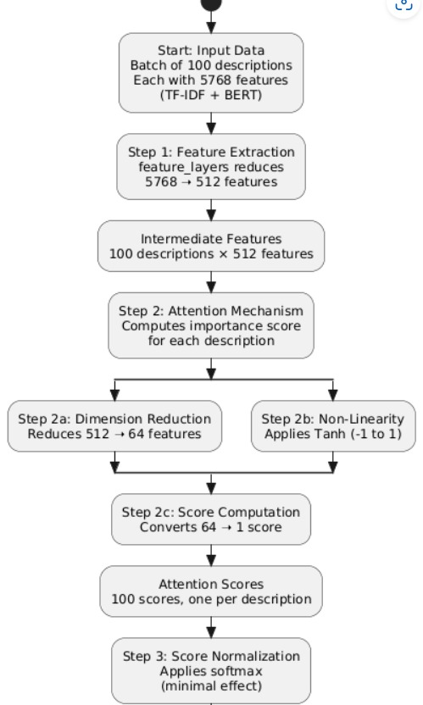
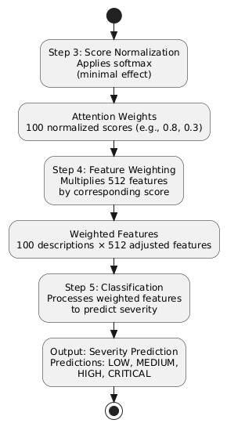
How it works?

Slide 20
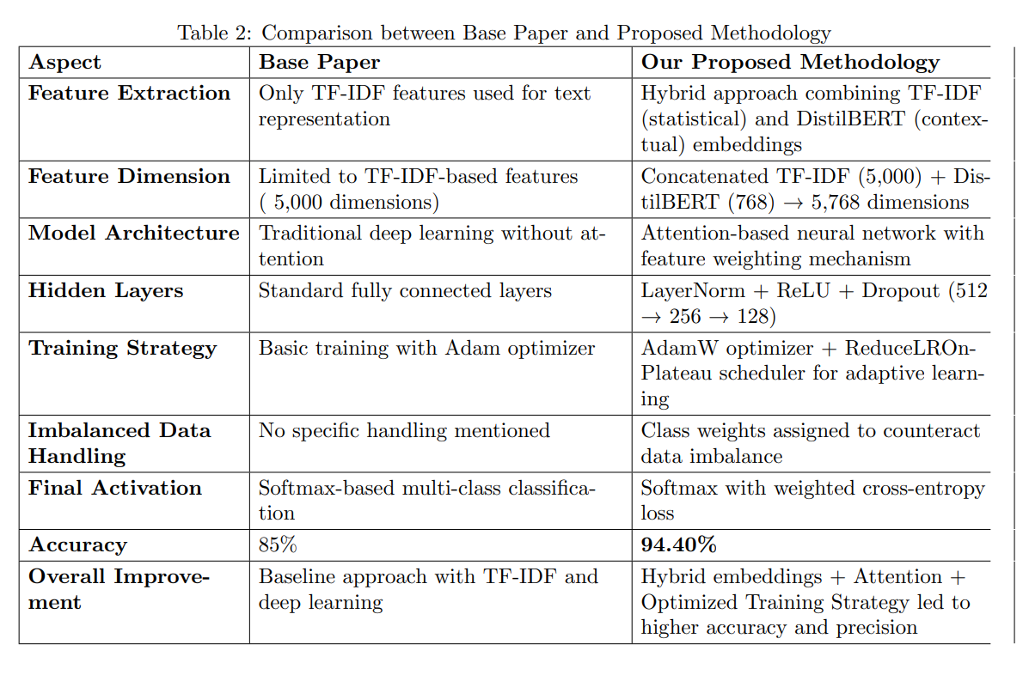
Comparison with our base paper

Slide 21
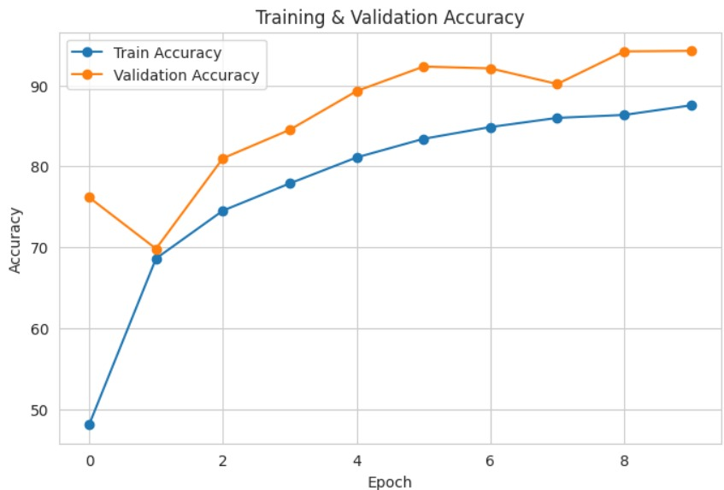
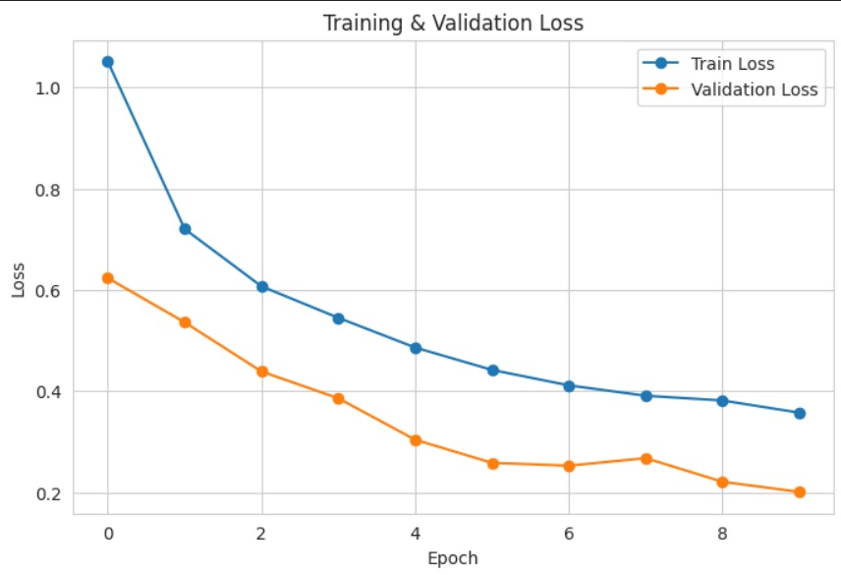
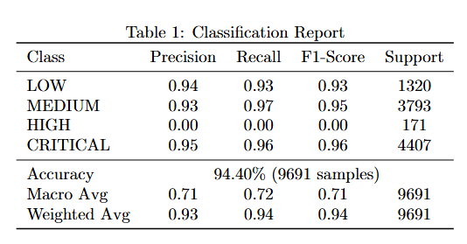
RESULT & CONCLUSION:

Slide 22
The model's training performance is visualized through two key graphs:
Training & Validation Loss: The training loss (blue) steadily decreases, indicating effective learning.
The validation loss (orange) also decreases with some oscillations, suggesting variability in handling new data.
Both converging to lower values indicates good generalization.
Training & Validation Accuracy: The training accuracy (blue) consistently improves, while the validation
accuracy (orange) increases with slight fluctuations, reflecting adaptation.
Their near co-linearity suggests minimal overfitting.
These graphs highlight effective learning and strong generalization, ensuring reliable predictions on unseen data.

Slide 23
THANK YOU

